Slide 1
Corporate Open Source Governance
Prof. Dr. Dirk Riehle
Friedrich-Alexander University Erlangen-Nürnberg
FOSS B03
Notes:
It is Friedrich-Alexander University Erlangen-Nürnberg – FAU, in short.
Corporate identity wants us to say “Friedrich-Alexander University”.

Slide 2
Governance and Compliance
Organizational governance
  Is “the way the rules, norms and [desired] actions [of an organization] are produced, sustained, regulated and held accountable” (Wikipedia)
Organizational compliance
  Is how any behavior of and within an organization is made to comply with that organization’s rules, norms, and desired actions [DR]
Software-using and producing organizations
  Can have all kinds of governance and compliance bodies
  One form is open source governance and compliance

Slide 3
Open Source Governance and Compliance
Open source governance and compliance
  Is the way an organization manages its open source engagement
  License compliance is different from organizational compliance
The three key forms of open source engagement
  Use (of open source software in products)
  Contribute (to open source software projects)
  Create or lead (open source software projects)
In the following, governance includes compliance

Slide 4
Products and Services
Services, e.g. software-as-a-service (SaaS) are a product
  Service provider operates product for customers, no on-premise use
  Usually no upfront license fee, but maintenance fee (subscription)
Open source licenses still apply!
  The provision of the software as a service constitutes “distribution”
  Specifically the AGPLv3 was conceived for this case
Product from now on means both trad. software and SaaS

Slide 5
Primary Benefits of Using Open Source
Better
  Open source components can be of high quality
Faster
  Open source components are immediately available
Cheaper
  Open source components are free (no license fee)

Slide 6
Initial Motivation: Save Costs
Better
Cheaper
Faster
“High quality software free.”

Slide 7
Secondary Benefits
Open source is open to inspect, modify
  Faster: Users can help themselves, fix bugs
  Faster: Users can extend the software, develop new features
Most open source has no or little vendor lock-in
  Faster: Innovation cannot be blocked by one company
  Cheaper: Competition keeps service prices low
Open source components are compatible
  Faster, better: With standards (as reference implementations)
  Faster, better: With platforms (as de-facto implementations)

Slide 8
Mature Motivation: Focus Business
Better
Faster
Cheaper
“Focus on competitive differentiation.”

Slide 9
Detriments of Using Open Source
Attackers have it a bit easier to find security holes
  Various agencies scan open source for vulnerabilities, don’t report them
    Becomes more serious, if use of open source is signaled

Slide 10
Not Using Open Source is Not an Option
“We don’t use open source” signals …
  They may not know what their engineers are doing
  They may not have their business focus straight

Slide 11
The Software Supply Chain
Software vendor
product
Supplier tier 1
...
...
closed source
comp #24
open source
proj #5332
open source
proj #152
...
Supplier tier n
...
closed source
comp #897
open source
proj #832
open source
proj #21632

Slide 12
The Open Source Program Office
Open source goal and strategy formulation
  Should be led by VP of Engineering and CTO
  Typically leads to the creation of a program office
  Should be done together with the program office
Purpose of an open source program office
  Serves as a point-of-contact
  Manages governance processes
  Manages governance itself
Also sometimes called a competence center

Slide 13
Goals of Open Source Governance
Achieving goals while
Avoiding problems
At minimal cost

Slide 14
Achieving Goals for Using Open Source
Focus business
  Identification of open source opportunity
Save costs
  Selection of open source component
  Inclusion of component in product
  Management of open source investment

Slide 15
Example Governance for Achieving Goals
Identify open source opportunities
  Product manager determines business focus and engineering manager identifies correlating open source opportunities
Select open source component
  Engineering manager and software architect define criteria for open source component, select best fitting one; includes clearance process
Include open source component
  Software architect and software developer include open source component in product and bill-of-materials
Manage open source investment
  Engineering manager, software architect, and software developer monitor the evolution of the open source component, engage when necessary

Slide 16
Avoiding Problems with Using Open Source
Example of Legal challenges
  Ensure usage rights as intended (license compliance)
Example of Quality challenges
  Ensure new security holes are recognized and fixed
Example of Process challenges
  Avoid maintenance burden by contributing back

Slide 17
Cause and Effect Chain of Legal Problems
Company
Behavior
Potential
Problem
Materialized
Problem
Unwanted
Consequences
Problematic use of open source
Non-compliance with license
Subjected to lawsuit
Out-of-court settlement
Careless provision of software
Threatened with lawsuit
Loss in court
Ungoverned contribution
Suspected of
non-compliance
Reputation loss with community
Loss of goodwill with community

Slide 18
Copyright Violation Lawsuit
Steps in process
  Customer C acquires license for commercial product P from software vendor V
  Customer asks software vendor for source code; in all likelihood gets denied
  Depending on license and technical coupling, this denial is a license violation
C
V
May sue vendor
May ask for
source code
Develops
and sells
OSS
P
Used to create
derived work
OSS

Slide 19
Patent Infringement Lawsuit
Setup of situation
  OSS contains code that implements
  patent owned by patent holder O
  Software vendor sells license for P
  to customer C without licensing patent
Steps in process
  Patent holder sues customer
  (patent user)
  Customer turns around, sues
  software vendor
Applies broadly
  To both use-cases
    In-house
    In products
O
C
Sues
Discovers use of patent
Buys product
Uses warranties
V
Develops
and sells
OSS
P
Used to create
work
OSS

Slide 20
Costs of Materialized Problems
When threatened with lawsuit
  Legal costs
  Reputation loss
  Wasted management attention
When subjected to lawsuit, like before +
  Undesired revealing of information

Slide 21
Costs of Unwanted Consequences
When settling out-of-court, like before +
  Financial costs
  Compliance costs
When losing in court, like before +
  Financial costs
    License and other fees
    Potential punitive damages
  Product revenue loss due to …
    Product recall / sales stop
    Delay of product releases
  Compliance costs
  Increased risks of more lawsuits

Slide 22
Costs of Establishing License Compliance
In case of component replacement
  Development costs (rework)
  New component licensing fees
In case of non-replacement
  Labor costs (compliance artifacts)
  Intellectual property loss
    Exclusivity of source code
    Potential free patent rights grant
  Undesired revealing of information

Slide 23
Probability of Getting Sued
Sources of lawsuits
  GPL enforcers
  GPL monetizers

Slide 24
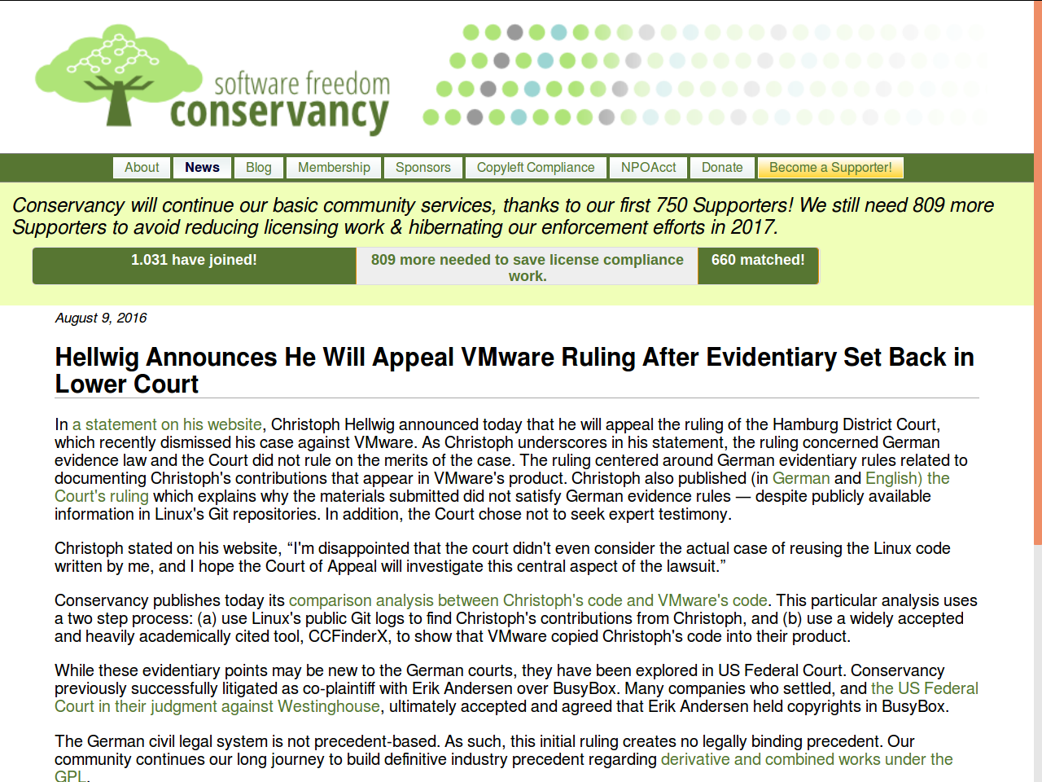

Slide 25
GPL Monetization and Netfilter [KS16]
Specifically, we remain aware of multiple non-community-oriented GPL enforcement efforts [...] These “GPL monetizers”, who trace their roots to nefarious business models that seek to catch users in minor violations in order to sell an alternative proprietary license, stand in stark contrast to the work that Conservancy, FSF and gpl-violations.org have done for years.
Most notably, a Linux developer named Patrick McHardy continues ongoing GPL enforcement actions […] In the last two years, we've heard repeated rumors about Patrick's enforcement activity, as well as some reliable claims by GPL violators that Patrick failed to follow the Principles.
Patrick’s enforcement occurs primarily in Germany. We know well the difficulties of working transparently in that particular legal system, but both gpl-violations.org and Conservancy have done transparent enforcement in that jurisdiction and others.
Patrick McHardy has also been suspended from work on the Netfilter core team. While the Netfilter team itself publicly endorsed these Principles of enforcement, Patrick has not. Conservancy agrees that Patrick's apparent refusal to endorse the Principles leaves suspicion and concern, since the Principles have been endorsed by so many other Linux copyright holders, including Conservancy.

Slide 26
The CEO’s Liability
Good open source governance is “state of the art”
  Many large companies demonstrate how to do it
  Therefore, good governance is responsibility of the CEO
Leads to liability of the CEO resp. “Geschäftsführerhaftung”

Slide 27
Proactive Measures against Patent Lawsuits
Open Invention Network (OIN) founded to protect Linux
  OIN owns a large patent pool that it licenses out royalty-free
  Requires that licensees agree not to enforce patents against Linux
Modern open source licenses include patent retaliation clauses
  Users of open source, who enforce patents, loose right to use open source
  Retaliation clauses are not present in older licenses, e.g. not in GPLv2

Slide 28
Patent Retaliation Lawsuit
2. loss of rights grant
C1
V2
Setup of situation
  Both V1 and V2
  contribute to OSS
Original lawsuit
  V2 sues C1 for patent
  patent infringement
  C1 turns around, holds
  supplier V1 responsible
Retaliation lawsuit
  V1 sues C2 for
  copyright violation
  C2 turns around, holds
  supplier V2 responsible
1. lawsuit
P1
OSS
P2
OSS
OSS
V1
C2
3. “retaliation” lawsuit

Slide 29
Use of Open Source is a Business Decision
No risk
No reward
How to manage this risk?

Slide 30
Example Governance for Legal Problems
Developer education
  Educate developers, refresh education, provide handbook, …
Open source clearance process
  Have clearance process, define point-of-contact, provide veto rights, …
Supplier management
  Manage suppliers, define acceptable licenses, require bill-of-materials, …

Slide 31
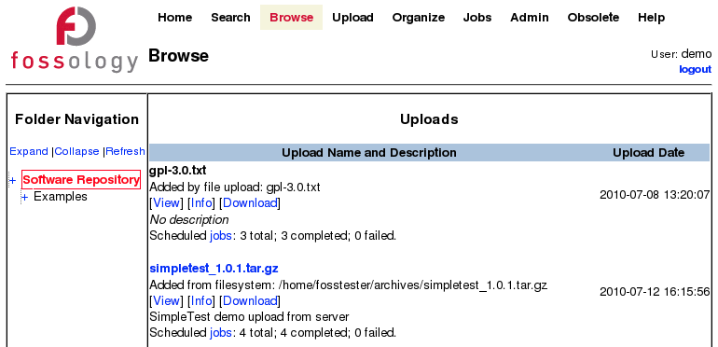
Component Analysis 1 / 2

Slide 32
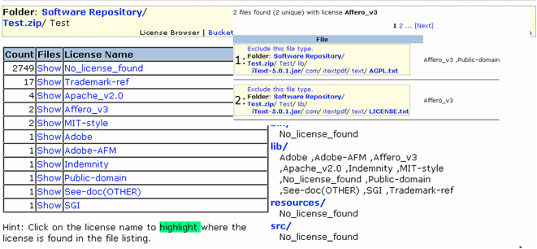
Component Analysis 2 / 2

Slide 33
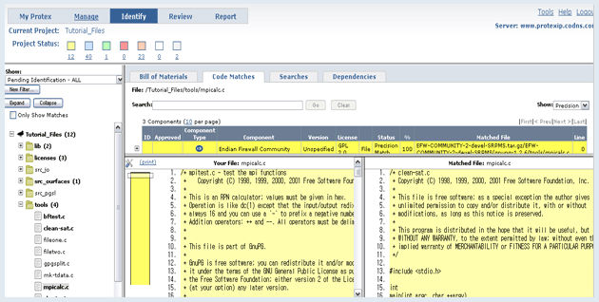
Source Code Scanner 1 / 2

Slide 34
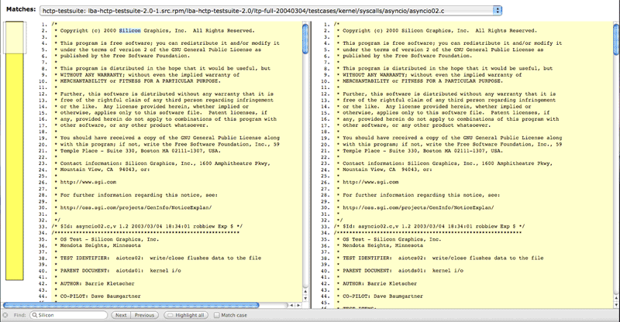
Source Code Scanner 2 / 2

Slide 35
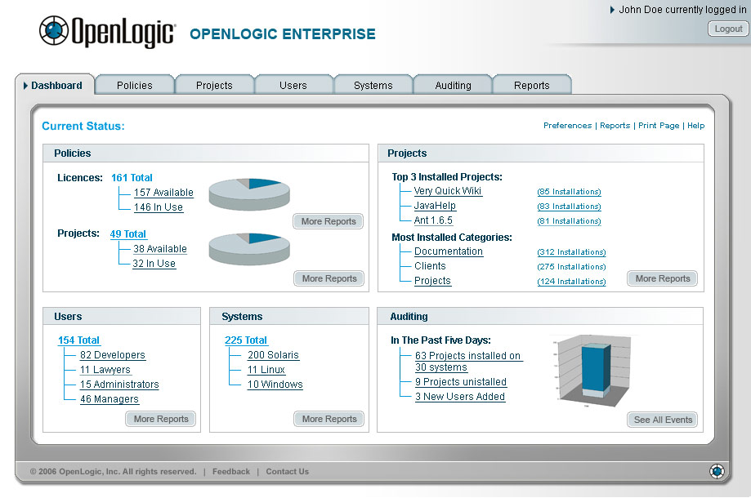
Repository Management 1 / 2

Slide 36
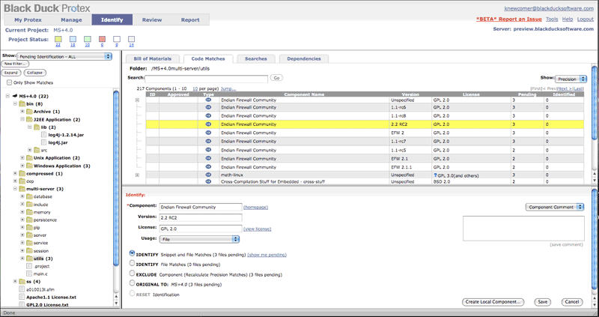
Repository Management 2 / 2

Slide 37
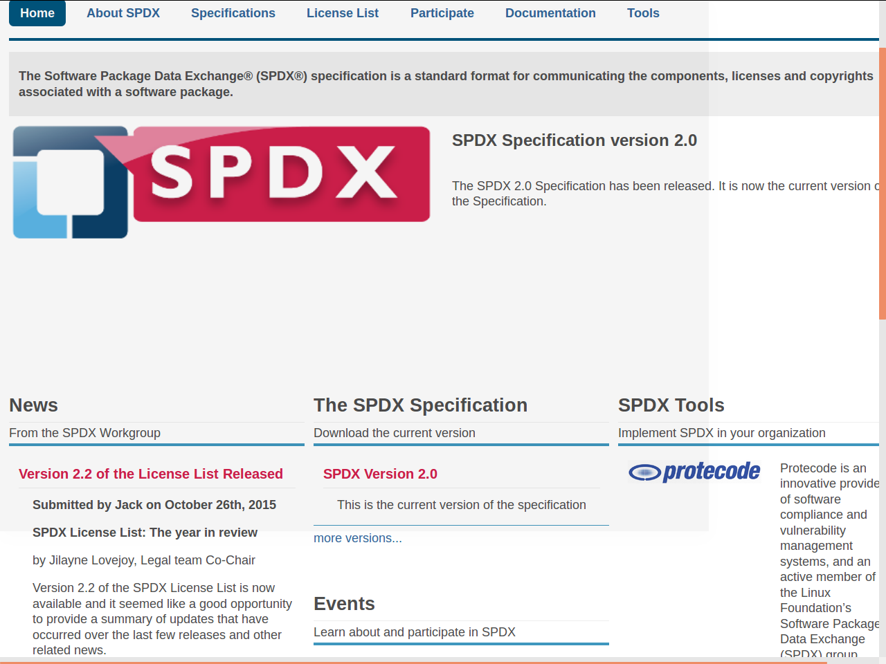
Software Package Data Exchange (SPDX)

Slide 38
Security Problems with Using Open Source
Vulnerabilities will be widely known once made public
  But there is no supplier that informs its users about it
Attackers have more options for finding vulnerabilities
  Source code is public, which allows for additional attack angles
Attackers find their targets more easily
  Unless controlled carefully, most companies signal use

Slide 39
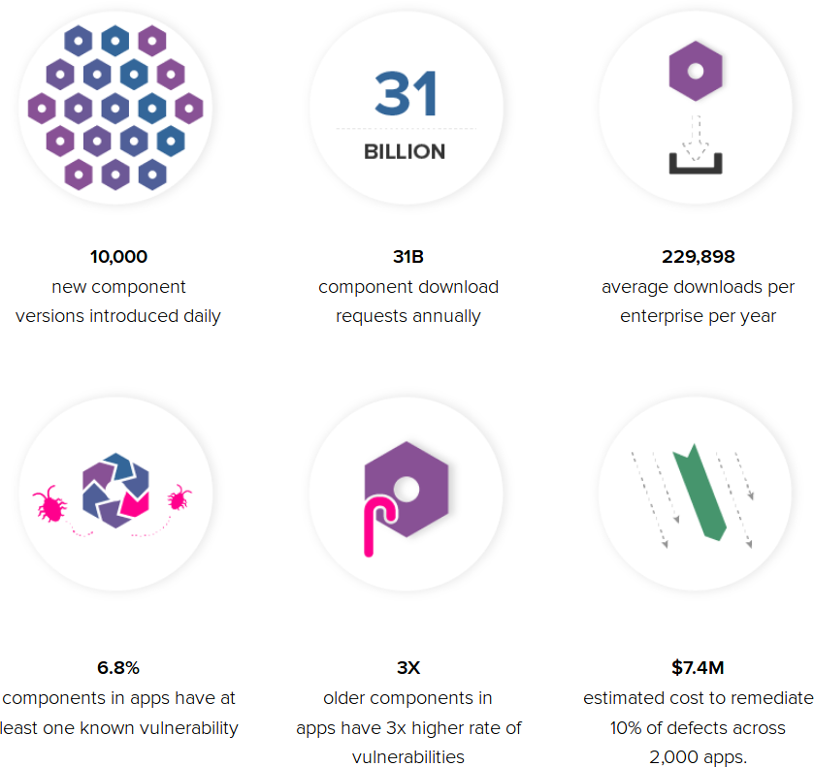
Seriousness of Vulnerabilities [S16]

Slide 40
Example Governance for Security Problems
Vulnerability identification
  Bounty programs, vulnerability monitoring, …
Vulnerability triage
  Exposure analysis, removal costs, …
Vulnerability removal
  Installation tracking, update provision, …

Slide 41
Process Problems with Using Open Source
Product with project alignment
  Schedule alignment
    Neither schedule nor feature set may be predictable
  New function development
    Competitive situation may require closed development
  Avoiding maintenance burden
    Developers want to “contribute back” bug fixes or small improvements
    Such contribution signals company’s use of the software
    Such signaling notifies attackers (both legal and security)

Slide 42
Seriousness of Process Problems
Schedule alignment
  Well-run open source projects have a predictable schedule
  Feature set may not be predictable though
New function development
  Closed development may simply be a competitive requirement
  Creates stress on contribution and integration (cf. Linux kernel)
Avoiding maintenance burden
  Can be mediated through appropriate governance

Slide 43
Example Governance for Maintenance Burden
Contribution review
  Define point-of-contact, review competitive exposure, …
Contribution execution
  Appoint gatekeeper, involve external contributor, …

Slide 44
Example Governance for Minimizing Costs
Minimizing costs = process and resource efficiency
Define clear roles and assign responsibilities
Provide as much self-help as possible

Slide 45
Governance Domains and Processes
 | Roles | Practices | Artifacts
Governance management | CEO Program officer Legal counsel ... | Define goals Define processes Define roles … ... | Open source charter Process descriptions Practices handbook ...
Supplier management | Program officer Software architect Engineering manager Supplier, ... | Enable audits Require bill-of-materials Explain governance ... | Audit checklist Bill-of-materials Educational materials ...
Engineering management | Program officer Engineering manager Supplier, ... | Review third-party Select component Monitor code commits ... | Deliverables checklist Component repository Code scanner ...
Product management | Program officer Product manager Engineering manager ... | Ensure standards Comply with licenses Provide source code ... | Platform specifications Open source licenses Source code browser ...
Software development | Program officer Software developer Engineering manager ... | Teach practices Suggest component Use comp. repository ... | Practices handbook Code search engines Code scanner ...

Slide 46
Roles and Responsibilities
Program officer (PO)
  Responsible for governance
    Defines processes and practices
    Collaborates and mediates
    Signs-off or escalates
Other involved parties
  Top-level management (CEO)
    Defines strategic goals
  Legal counsel (LG)
  Engineering manager (EM)
  Product manager (PM)
  Software architect (SA)
  Software developer (SD)
CEO
LG
PO
SA
EM
PM
SD

Slide 47
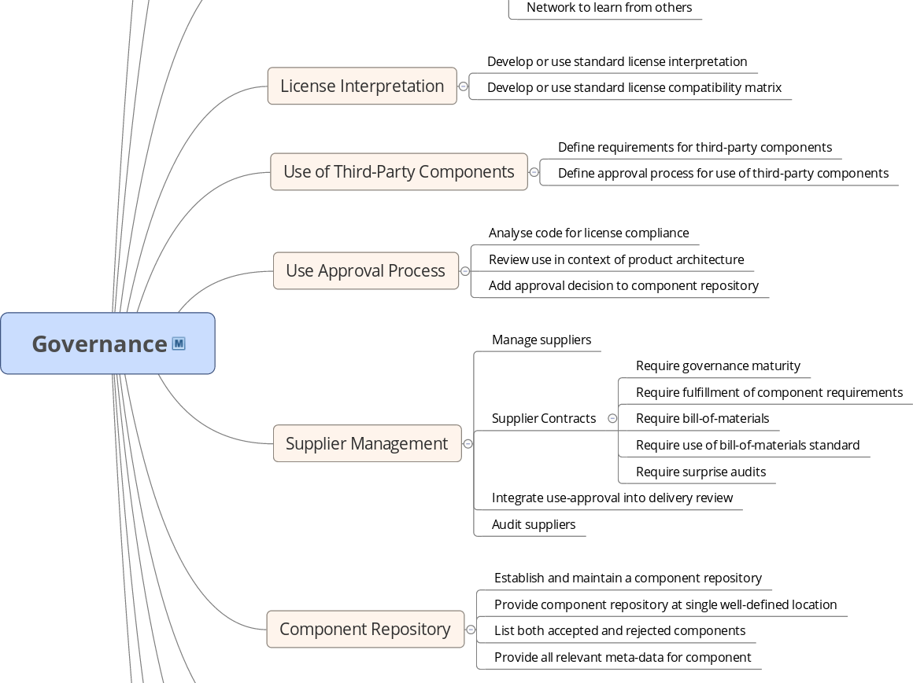
Governance Process and Practices [1]
[1] This figure is a small excerpt of the Bayave GmbH (Prof. Riehle) handbook for open source governance

Slide 48
Best Practice Descriptions
Short | Name
Main responsible | Actor
(Abstract form of) | Context | of problem
(Abstract form of) | Problem | at hand
(Abstract form of) | Solution | of problem

Slide 49
Generate Compliance Artifacts
Name | Generate compliance artifacts
Actor | Product manager
Context | The product is getting ready for release. You previously → determined (all relevant) compliance artifacts.
Problem | You will have to include all relevant compliance artifacts in the upcoming release.
Solution | Generate all relevant compliance artifacts from sources. Automate the generation as much as possible to avoid mistakes in an otherwise laborsome but dull process. Once the product is ready for release, you’ll have to → provide (all relevant) compliance artifacts.

Slide 50
Manage Suppliers
Name | Manage suppliers
Actor | Engineering manager
Context | Your product includes not only open source components, but also third-party components that are supplied to you by other software vendors. In contrast to open source projects, you are paying for the component (license) and you are receiving it from a corporate entity. You previously → defined (your) component requirements and they must be met by any component, open source or not.
Problem | How to ensure that a third-party component delivery meets your requirements?
Solution | First, before you select a supplier, you may → require governance certification or at least → require (a minimum) governance maturity of them. Once you have decided for a supplier, in any delivery contract, you should → require fulfillment of your component requirements and you should → require a bill-of-materials upon delivery for which you → require they use a bill-of-materials standard. Upon delivery, you have to → ensure requirements are met and for this, you have to → integrate use-approval into the delivery process. If the supplier isn’t certified and having to reject a component delivery is too expensive, you may want to → enable surprise audits and consequently also → perform surprise audits as to best governance practices.

Slide 51
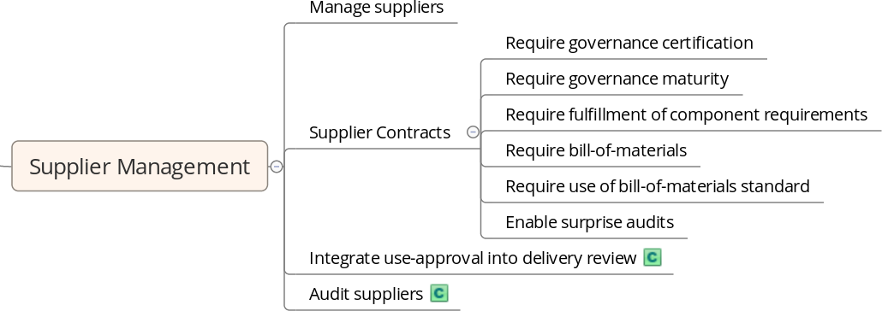
Manage Suppliers in Context

Slide 52
Quiz: Organizational Structure
Where to put the open source program office?
  Into product management
  Into engineering management
  Into legal department
  Independent (staff function)

Slide 53
Review / Summary of Session
Open source governance
  Strategic goals (cost savings, business focus)
  Challenges to using open source in products
  Process and resource efficiency
Provision and communication
  Definition of an open source program office
  Program office charter, roles and responsibilities
  A handbook of processes and practices

Slide 54
Thank you! Questions?
dirk.riehle@fau.de – http://osr.cs.fau.de
dirk@riehle.org – http://dirkriehle.com – @dirkriehle
DR

Slide 55
Credits and License
Original version
  © 2012-2019 Dirk Riehle, all rights reserved
Contributions
  ...

